Slide 1

Chapter 15
預訓練模型與轉移學習
01

Slide 2
Keras應用程式
Xception
VGG16
VGG19
ResNet, ResNetV2, ResNeXt
InceptionV3
InceptionResNetV2
MobileNet
MobileNetV2
DenseNet
NASNet
一些Keras內建已經成功完成訓練的深度學習模型，除了模型結構，還包含預訓練的權重，也稱為「預訓練模型」。
02

Slide 3
from keras.applications.mobilenet import MobileNet
model = MobileNet(weights=“imagenet”, include_top=True)
• weights參數
模型使用的權重，參數值imagenet是使用ImageNet的預訓練權重。參數值為None，指使用模型結構，需自行訓練權重。
• include_top參數
是否包含模型頂部的完全連階層，指平坦層後的分類神經層，參數值True表示有包含；False表示不包含分類神經層，模型只有特徵萃取的神經層，可自行新增所需的分類神經層，稱為學習轉移。
03

Slide 4
使用預訓練模型進行圖片分類預測
01
02
03
04
Mobile
RasNet50
InceptionV3
VGG16
04

Slide 5
使用MobileNet預訓練模型
from keras.preprocessing.image import img_to_array
from keras.preprocessing.image import load_img
from keras.applications.mobilenet impor MobileNet
from keras.applications.mobilenet impor preprocess_input
from keras.applications.mobilenet impor decode_predictions
#建立MobileNet模型
model = MobileNet(weights=“imagenet”, include_top=True)
#載入測試圖片
img = load_img(“koala.png”, target_size=(224, 224))
x = img_to_array(img) #轉換成Numpy陣列
Print(“x.shape: “, x.shape)
x.shape: (224, 224, 3)
05

Slide 6
使用MobileNet預訓練模型
#資料預處理
img= x.reshape((1, x.shape[0], x.shape[1], x.shape[2]))
img = preprocess_input(img)
Print(“img.shape: “, img.shape)
img.shape: (1, 224, 224, 3)
#使用模型進行測試
Y_pred = model.predict(img)
#解碼預測結果
label =decode_predictions(Y_pred)
result = label[0] [0] #取得最可能的結果
print(“%s (%.2f%%)” % (result[1], result[2]*100))
Koala (100.00%)
06

Slide 7
使用ResNet50預訓練模型
model = ResNet50(weights=“imagenet”, include_top=True
img = load_img(“koala.png”, target_size=(224, 224))
x = img_to_array(img)
print(“x.shape: “, x.shape)
img= x.reshape((1, x.shape[0], x.shape[1], x.shape[2]))
img = preprocess_input(img)
Print(“img.shape: “, img.shape)
Y_pred = model.predict(img)
label =decode_predictions(Y_pred)
result = label[0] [0]
print(“%s (%.2f%%)” % (result[1], result[2]*100))
x.shape: (224, 224, 3)
img.shape: (1, 224, 224, 3)
Koala (99.93%)
07

Slide 8
使用InceptionV3預訓練模型
model = InceptionV3 (weights=“imagenet”, include_top=True
img = load_img(“koala.png”, target_size=(299, 299))
x = img_to_array(img)
print(“x.shape: “, x.shape)
img= x.reshape((1, x.shape[0], x.shape[1], x.shape[2]))
img = preprocess_input(img)
Print(“img.shape: “, img.shape)
Y_pred = model.predict(img)
label =decode_predictions(Y_pred)
result = label[0] [0]
print(“%s (%.2f%%)” % (result[1], result[2]*100))
x.shape: (299, 299, 3)
img.shape: (1, 299, 299, 3)
Koala (91.51%)
08

Slide 9
使用VGG16預訓練模型
model = VGG16 (weights=“imagenet”, include_top=True
img = load_img(“koala.png”, target_size=(224, 224))
x = img_to_array(img)
print(“x.shape: “, x.shape)
img= x.reshape((1, x.shape[0], x.shape[1], x.shape[2]))
img = preprocess_input(img)
Print(“img.shape: “, img.shape)
Y_pred = model.predict(img)
label =decode_predictions(Y_pred)
result = label[0] [0]
print(“%s (%.2f%%)” % (result[1], result[2]*100))
x.shape: (224, 224, 3)
img.shape: (1, 224, 224, 3)
Koala (100.00%)
09

Slide 10
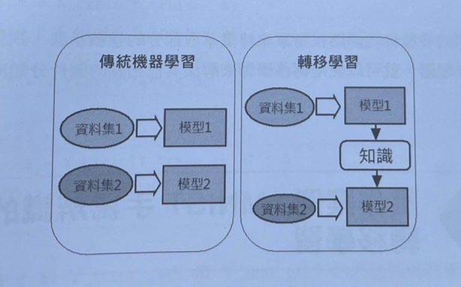
轉移學習
一種機器學習技術，可將原來針對指定任務所建立的已訓練模型，直接更改任務來訓練出解決其他相關任務的模型。
10

Slide 11
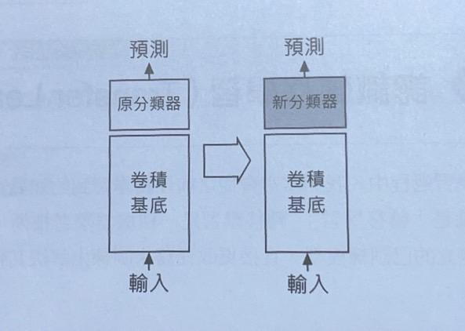
深度學習的卷積網路
使用多組卷積和池化層開始的神經層，可以執行特徵萃取。
卷積底層
在卷積基底後是使用Dense全連接層建立的分類器。
分類器
11

Slide 12
Example
MNIST手寫辨識的轉移學習
12

Slide 13
#匯入相關模組和套件，並指定亂數的種子數
import numpy as np
from keras.datasets import mnist
from keras.models import Sequential
from keras.layers import Dense, Flatten, Conv2D, MaxPooling2D, Dropout
from keras.utils import to_categorical
seed = 7
np.random.seed(seed)
#呼叫load_data()函式載入MNIST資料集
(X_train, Y_train), (X_test, Y_test) = mnist.load_data()
#因訓練分成兩部分，先訓練前五個數再訓練後五個數字
X_train_lt5 = X_train[Y_train < 5]
Y_train_lt5 = Y_train[Y_train < 5]
X_test_lt5 = X_test[Y_test < 5]
Y_test_lt5 = Y_test[Y_test < 5]
X_train_gte5 = X_train[Y_train >= 5]
Y_train_gte5 = Y_train[Y_train >= 5] - 5
X_test_gte5 = X_test[Y_test >= 5]
Y_test_gte5 = Y_test[Y_test >= 5] - 5
13

Slide 14
#將原來標籤值5~9改為0~4，再將圖片轉為4D張量和浮點數型別
X_train_lt5 = X_train_lt5.reshape((X_train_lt5.shape[0], 28, 28, 1)).astype(“float32”)
X_test_lt5 = X_test_lt5.reshape((X_test_lt5.shape[0], 28, 28, 1)).astype(“float32”)
X_train_gte5 = X_train_gte5.reshape((X_train_gte5.shape[0], 28, 28, 1)).astype(“float32”)
X_test_gte5 = X_test_gte5.reshape((X_test_gte5.shape[0], 28, 28, 1)).astype(“float32”)
#訓練和測試資料集預處理。因為是固定範圍，執行資料正規化，將資料從0-255轉成0-1
X_train_lt5 = X_train_lt5 / 255
X_test_lt5 = X_test_lt5 / 255
X_train_gte5 = X_train_gte5 / 255
X_test_gte5 = X_test_gte5 / 255
#標籤資料預處理。將值0~4執行One-hot編碼
Y_train_lt5 = to_categorical(Y_train_lt5, 5)
Y_test_lt5 = to_categorical(Y_test_lt5, 5)
Y_train_gte5 = to_categorical(Y_train_gte5, 5)
Y_test_gte5 = to_categorical(Y_test_gte5, 5)
14

Slide 15
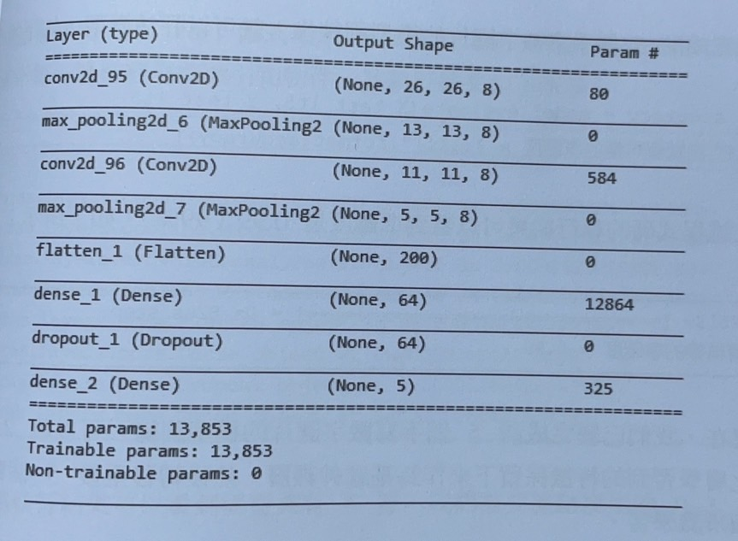
#定義CNN模型，使用2組卷積和池化層
model = Sequential()
model.add(Conv2D(8, kernel_size=(3, 3), input_shape=(28, 28, 1), activation=“relu”))
model.add(MaxPooling2D(pool_size=(2, 2)))
model.add(Conv2D(8, kernel_size=(3, 3), activation=“relu”))
model.add(MaxPooling2D(pool_size=(2, 2)))
model.add(Flatten())
model.add(Dense(64, activation=“relu”))
model.add(Dropout(0.25))
model.add(Dense(5, activation=“softmax”))
model.summary()
15

Slide 16
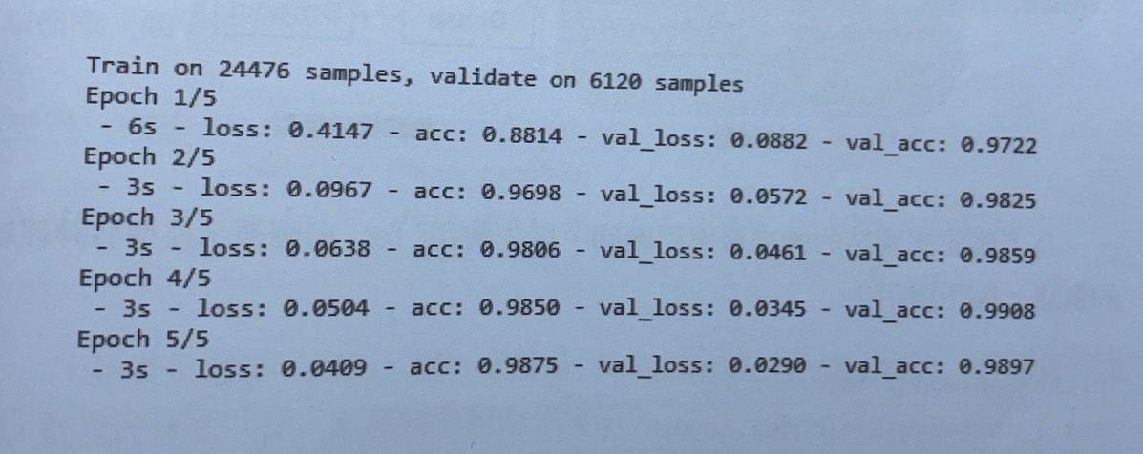
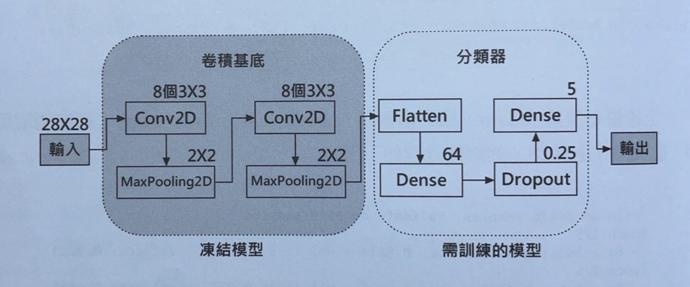
#編譯和訓練模型
model.compile(loss=“categorical_crossentropy”, optimizer=“adam”, metrics=[“accurancy”]
history = model.fit(X_train_lt5, Y_train_lt5, validation_spilt=0.2, epochs=5, batch_size=128, verbose=2)
#評估模型
loss, accurancy = model.evaluate(X_test_lt5, Y_test_lt5)
print(“測試資料集的準確度 = {:.2f}”.format(accurancy))
5139/5139 [==============================] – 0s 82us/step
測試資料集的值準確度 = 0.99
16

Slide 17
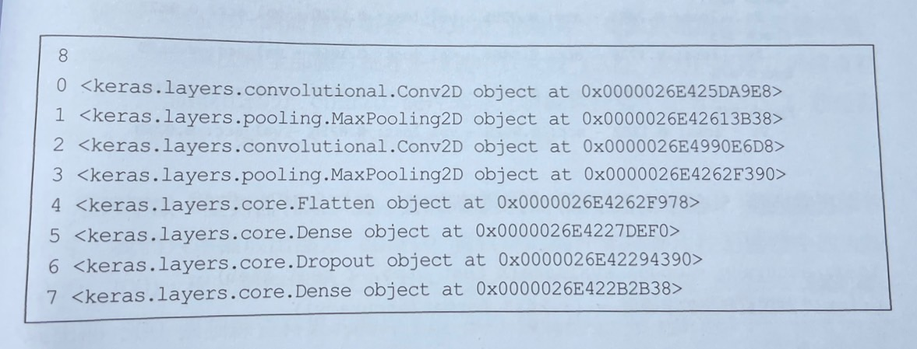
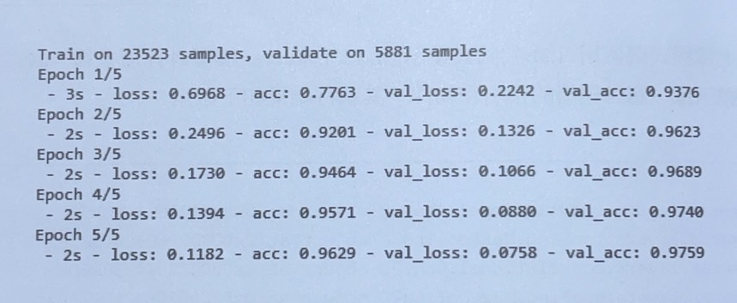
#使用for迴圈顯示模型各神經層資訊，確認需凍結的神經層索引範圍
print(len(model.layers))
for i in range(len(model.layers)):
print(i, model.layers[i])
#模型共8層，需凍結0~3層
for i in range(4):
model.layers[i].trainable = False
#需再次編譯模型才能訓練第二個轉移學習的分類模型
model.compile(loss=“categorical_crossentropy”, optimizer=“adam”, metrics=[“accurancy”]
history = model.fit(X_train_gte5, Y_train_gte5, validation_spilt=0.2, epochs=5, batch_size=128, verbose=2)
#評估模型
loss, accurancy = model.evaluate(X_test_gte5, Y_test_gte5)
print(“測試資料集的準確度 = {:.2f}”.format(accurancy))
4861/4861 [==============================] – 0s 99us/step
測試資料集的值準確度 = 0.98
17

Slide 18
Example
預訓練模型的轉移學習
18

Slide 19
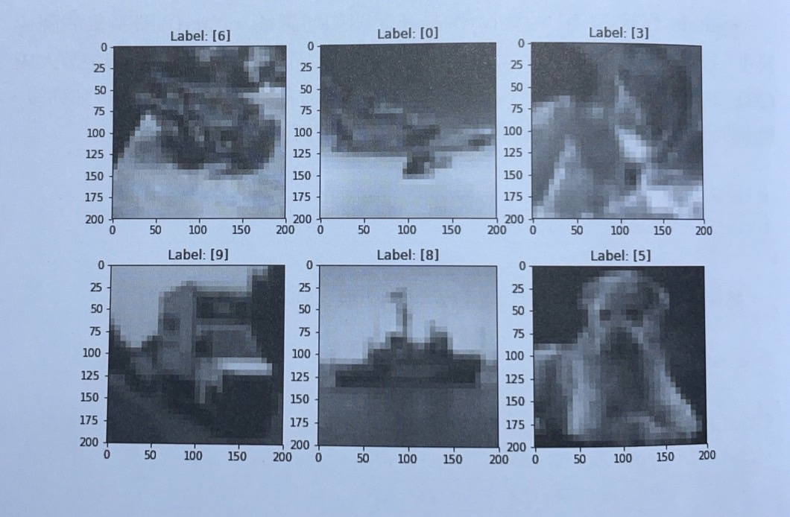
調整cifar10資料集的圖片尺寸
#取出前500張訓練資料集的圖片( 以500張為例 )
X_train = X_train[:500]
Y_train = Y_train[:500]
#將訓練資料集的圖片尺寸放大成(200,200)，並打亂Numpy陣列
from PLL import Image
˙˙˙
X_train_new = np.array([np.as array(Image.fromarray(X_train[i].resize(
(200, 200))) for i in range(0, len(X_train)])
#使用Matplotlib繪出前6張放大的圖片
fig = plt.figure(figsize=(10, 7))
sub_plot =230
for i in range(0, 6):
ax = plt.subplot(sub_plot + i + 1)
ax.imshow(X_train_new[i], cmap=“binary”)
ax.set_tittle(“Label: ” + str(Y_train[i]))
plt.show()
19

Slide 20
ResNet50預訓練模型的轉移學習
#取出前5000張訓練資料集的圖片(10%訓練和10%測試資料集)
X_train = X_train[:5000]
Y_train = Y_train[:5000]
X_test = X_test[:1000]
Y_test = Y_test[:1000]
#執行標籤資料的One-hot編碼
Y_train = to_categorical(Y_train, 10)
Y_test = to_categorical(Y_test, 10)
#載入ResNet50模型
resnet_model = ResNet50(weights=“imagenet”, include_top=False, input_shape=(200, 200, 3)
#使用ResNet50模型預測訓練資料集來輸出train_features特徵資料
X_train_new = np.array([np.asarray(Image.formarray(X_train[i].resize((200, 200))) for i in range(0, len(X_train))]
X_train_new = X_train_new.astype(“float32”)
train_input = preprocess_input(X_train_new)
train_features = resnet_model.predict(train_input)
20

Slide 21
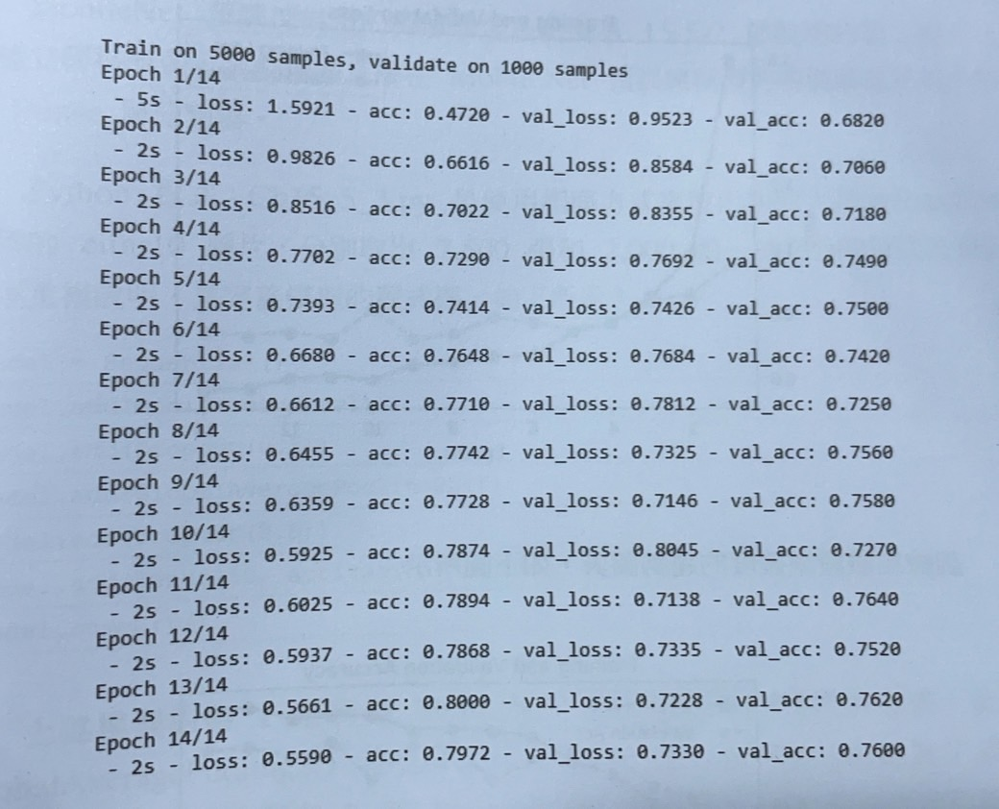
ResNet50預訓練模型的轉移學習
#使用ResNet50模型預測測試資料集來輸出test_features特徵資料
X_test_new = np.array(
[np.asarray(Image.formarray(X_test[i].resize(
(200, 200))) for i in range(0, len(X_test))]
X_test_new = X_test_new.astype(“float32”)
test_input = preprocess_input(X_test_new)
test_features = resnet_model.predict(test_input)
#定義分類器的神經網路
model = Sequential()
model.add(GlobalAveragePooling2D(
input_shape=train_features.shape[1:]))
model.add(Dropout(0.5))
model.add(Dense(10, activation=“softmax”))
#編譯和訓練模型
model.compile(loss=“categorical_crossentropy”, optimizer=“adam”,
metrics=[“accuracy”])
history = model.fit(train_features, Y_train,
validation_data=(test_features, Y_test),
epochs=14, batch_size=32, verbose=2)
21

Slide 22
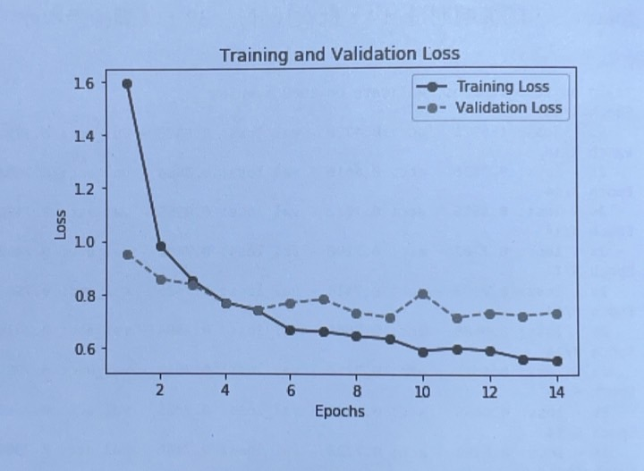
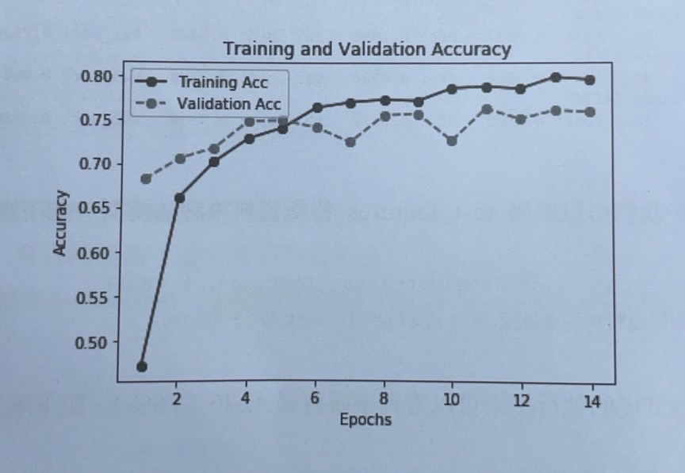
ResNet50預訓練模型的轉移學習
#使用test_features特徵資料來評估模型
loss, accuracy = model.evaluate(test_features, Y_test)
print(“測試資料集的準確度 = {:.2f}”.format(accuracy))
1000/1000 [==============================] – 0s 296us/step
測試資料集的值準確度 = 0.76
訓練和驗證損失的趨勢圖表
訓練和驗證準確度的趨勢圖表
22

Slide 23
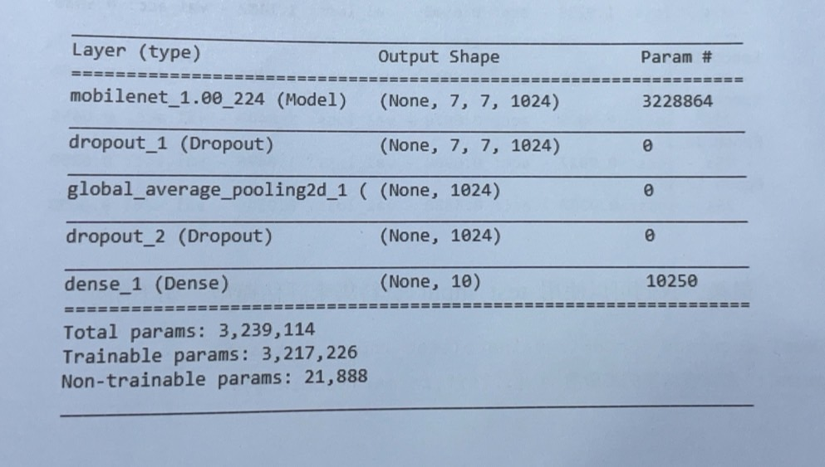
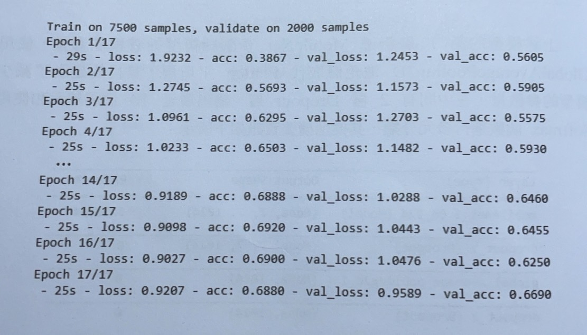
MobileNet預訓練模型的轉移學習
#這裡取出7500張和2000張與前面方法一樣(省略)，以下定義模型程式碼
model = Sequential()
model.add(mobilenet_model)
model.add(Dropout(0.5))
model.add(GlobalAveragePooling2D())
model.add(Dropout(0.5))
model.add(Dense(10, activation=“softmax”))
model.summary()
#凍結MobileNet預訓練模型的卷積基底
mobilenet.model.trainable = False
#編譯和訓練模型
model.compile(loss=“categorical_crossentropy”, optimizer=“adam”,
metrics=[“accuracy”])
history = model.fit(train_input, Y_train,
validation_data=(test_input, Y_test),
epochs=17, batch_size=32, verbose=2)
23

Slide 24
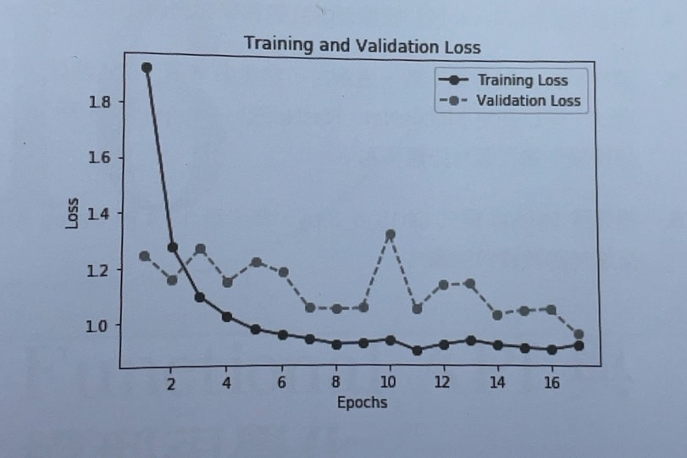
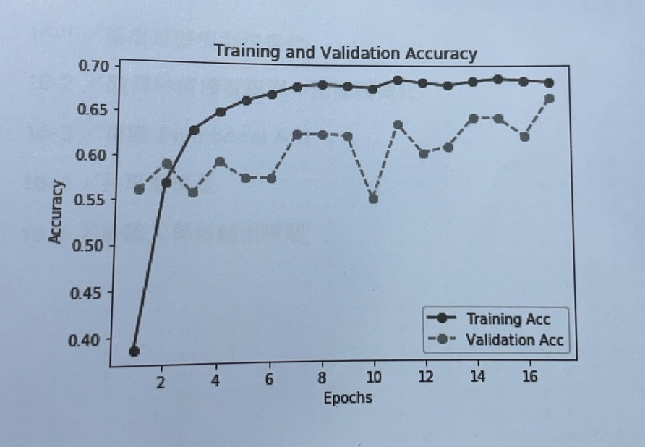
MobileNet預訓練模型的轉移學習
#使用test_input特徵資料來評估模型
loss, accuracy = model.evaluate(test_input, Y_test)
print(“測試資料集的準確度 = {:.2f}”.format(accuracy))
2000/2000 [==============================] – 6s 3ms/step
測試資料集的值準確度 = 0.67
訓練和驗證損失的趨勢圖表
訓練和驗證準確度的趨勢圖表
24

